Slide 1
Stock Price Predictions | Machine Learning
Chris, Billy, Saibal, & Danielle

Slide 2

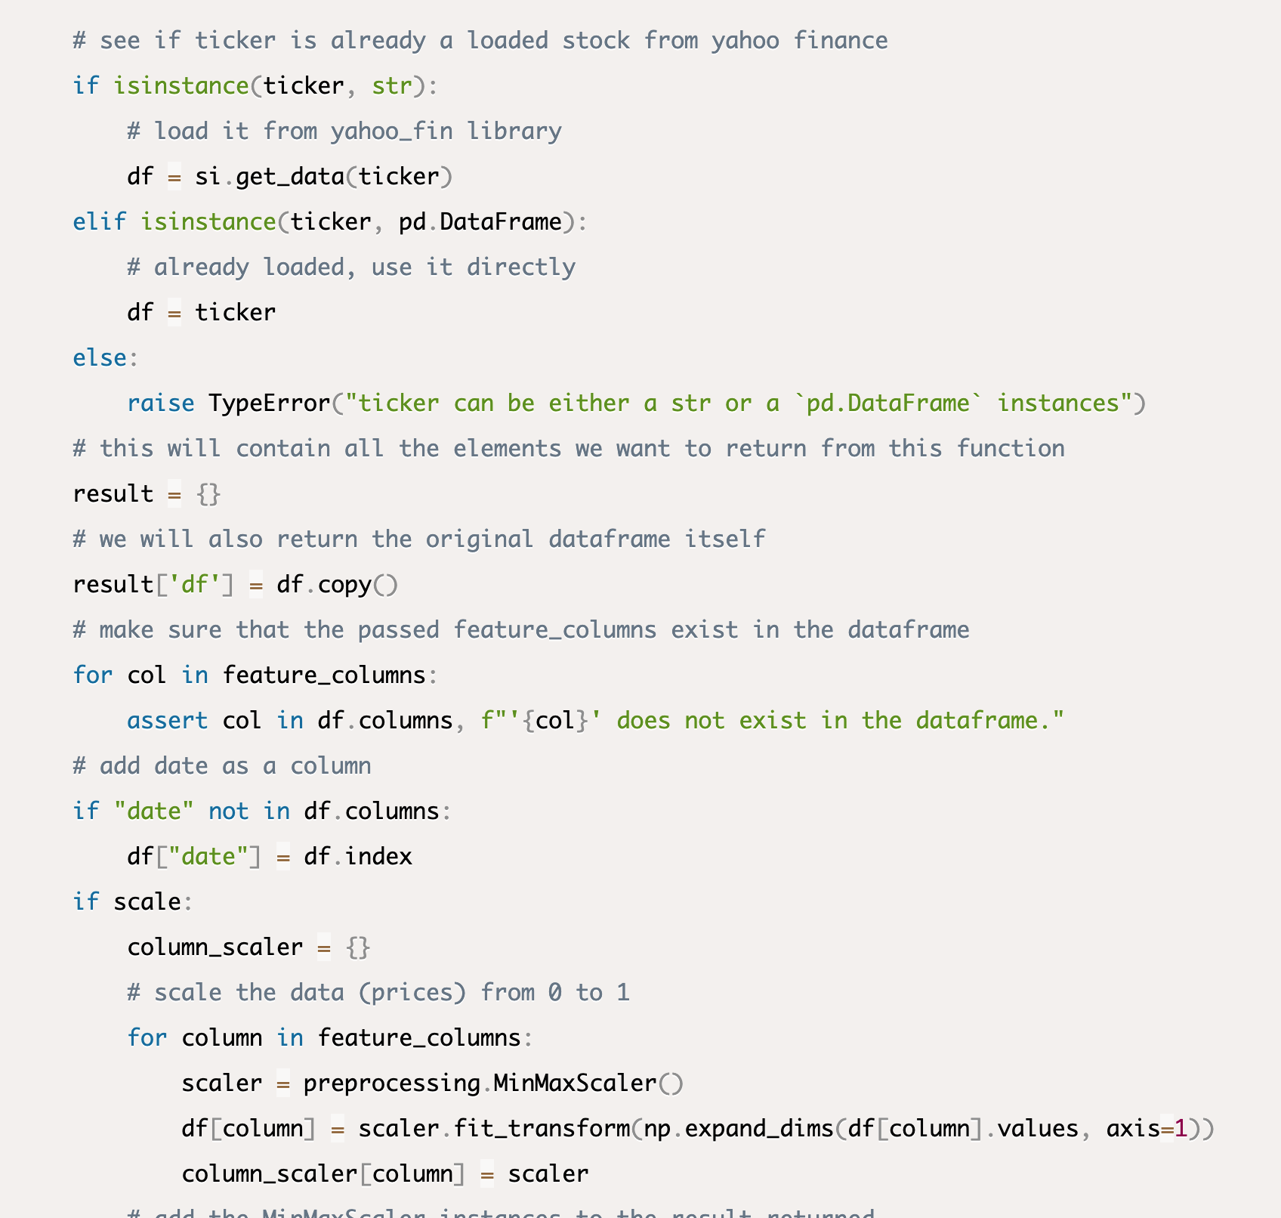
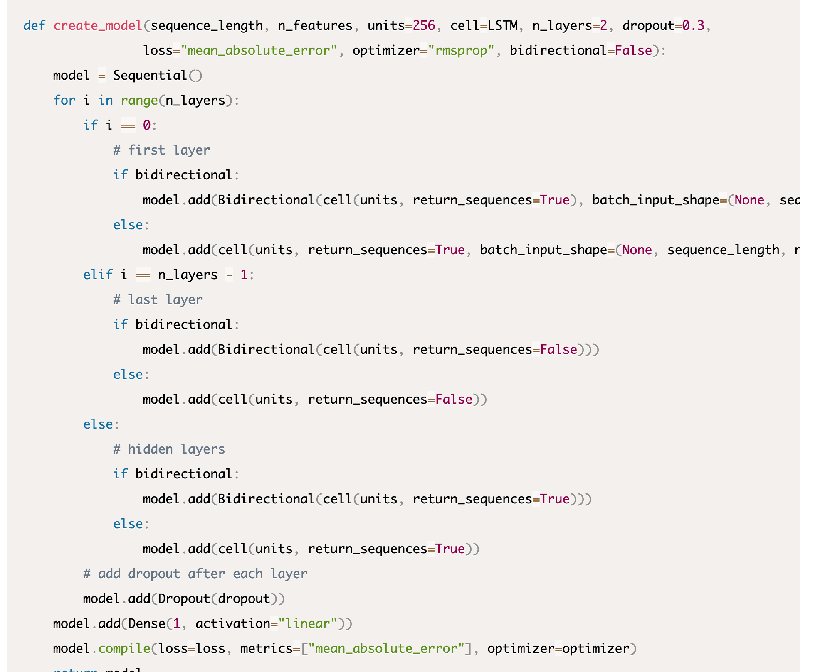
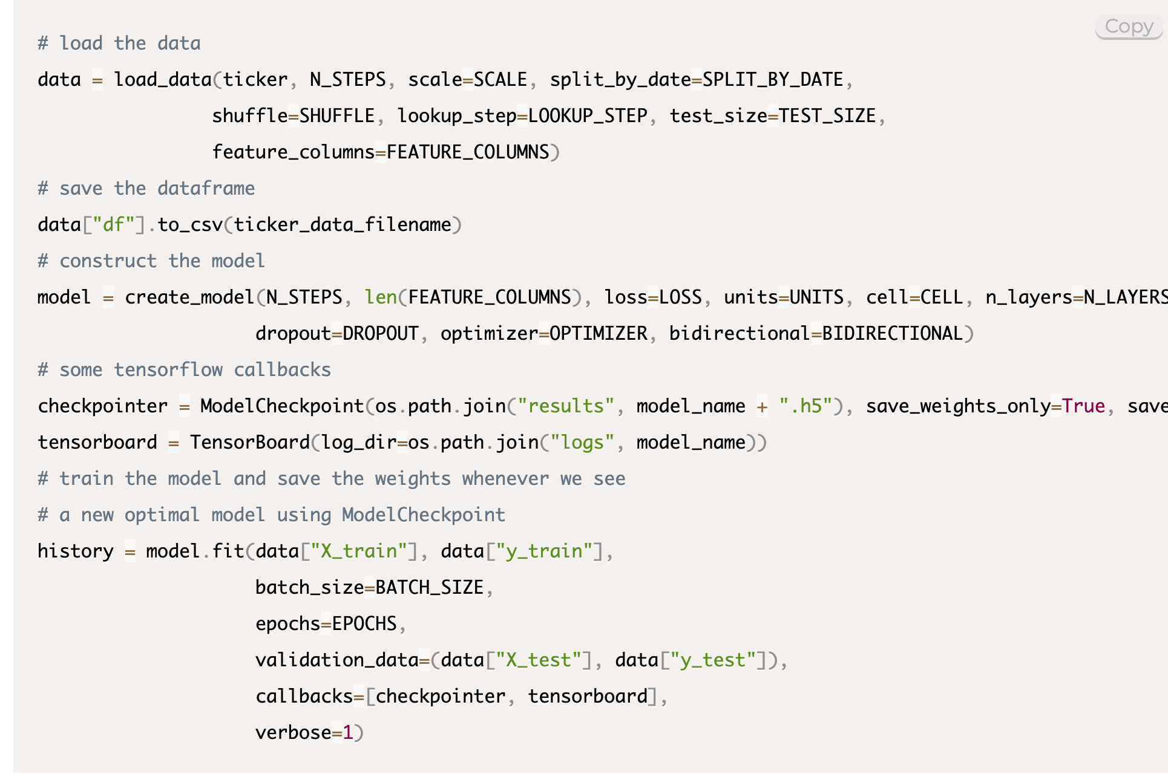
Data Collection
Yahoo Finance (http://theautomatic.net/yahoo_fin-documentation/)

Slide 3
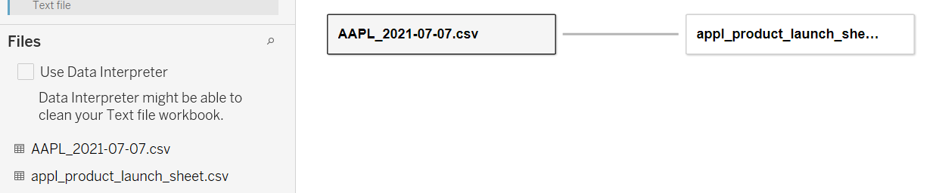
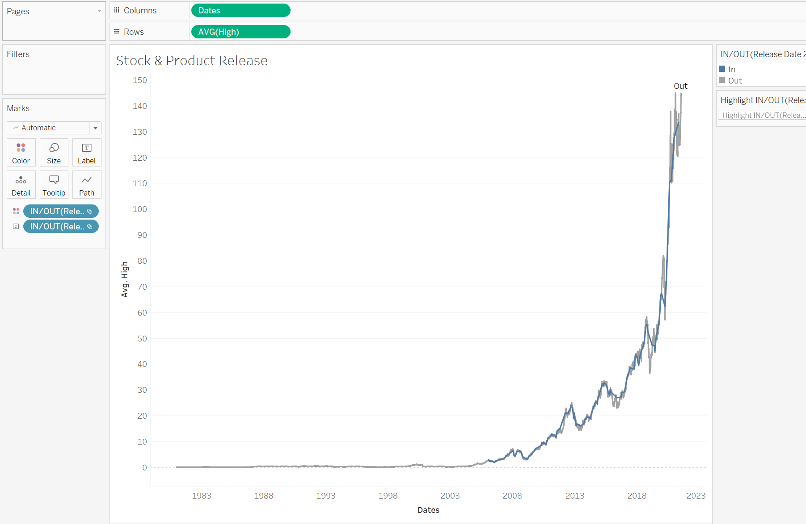
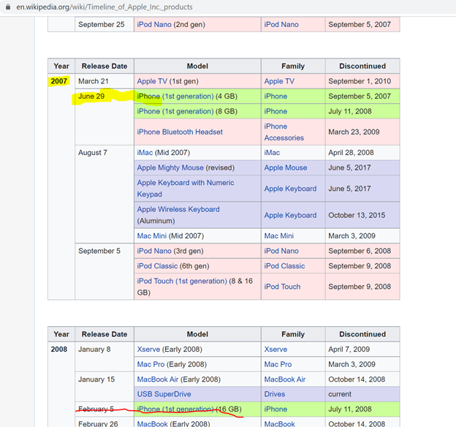
Hypothesis & Tableau
Data from Daniel + Saibal’s data for Apple product release (linked by dates).
If the average high price of AAPL goes up one month prior to a major phone product release, then future phone releases would indicate a stock increase a month leading up to a major phone release.
Notes:
Wiki link: https://en.wikipedia.org/wiki/Timeline_of_Apple_Inc._products Tableau link: https://public.tableau.com/app/profile/chris.obonaga/viz/Final_Project_16257499612660/iPhoneReleases

Slide 4
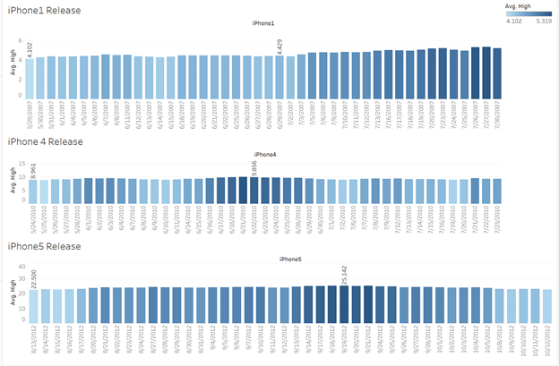
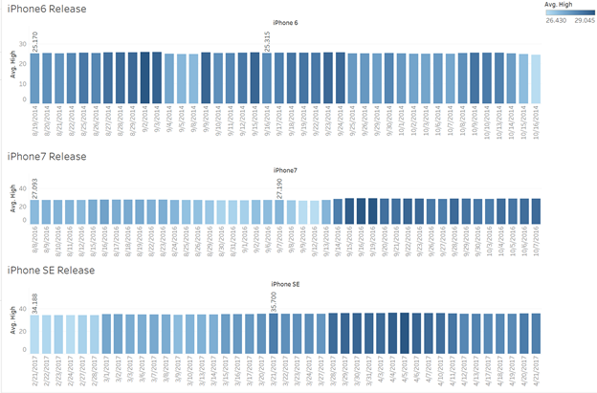
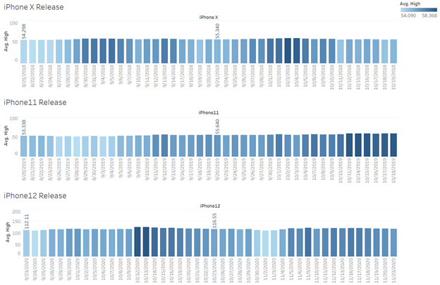
Hypothesis & Tableau
9 of 11 major iPhone releases yielded higher stock prices a month leading to the release date

Slide 5
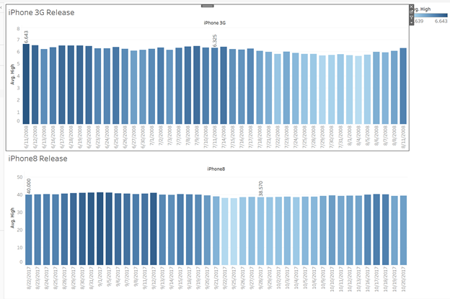
Hypothesis & Tableau
2 of 11 major iPhone releases yielded lower stock prices a month leading to the release date. One of those can be attributed to the recession when all stocks were down.

Slide 6
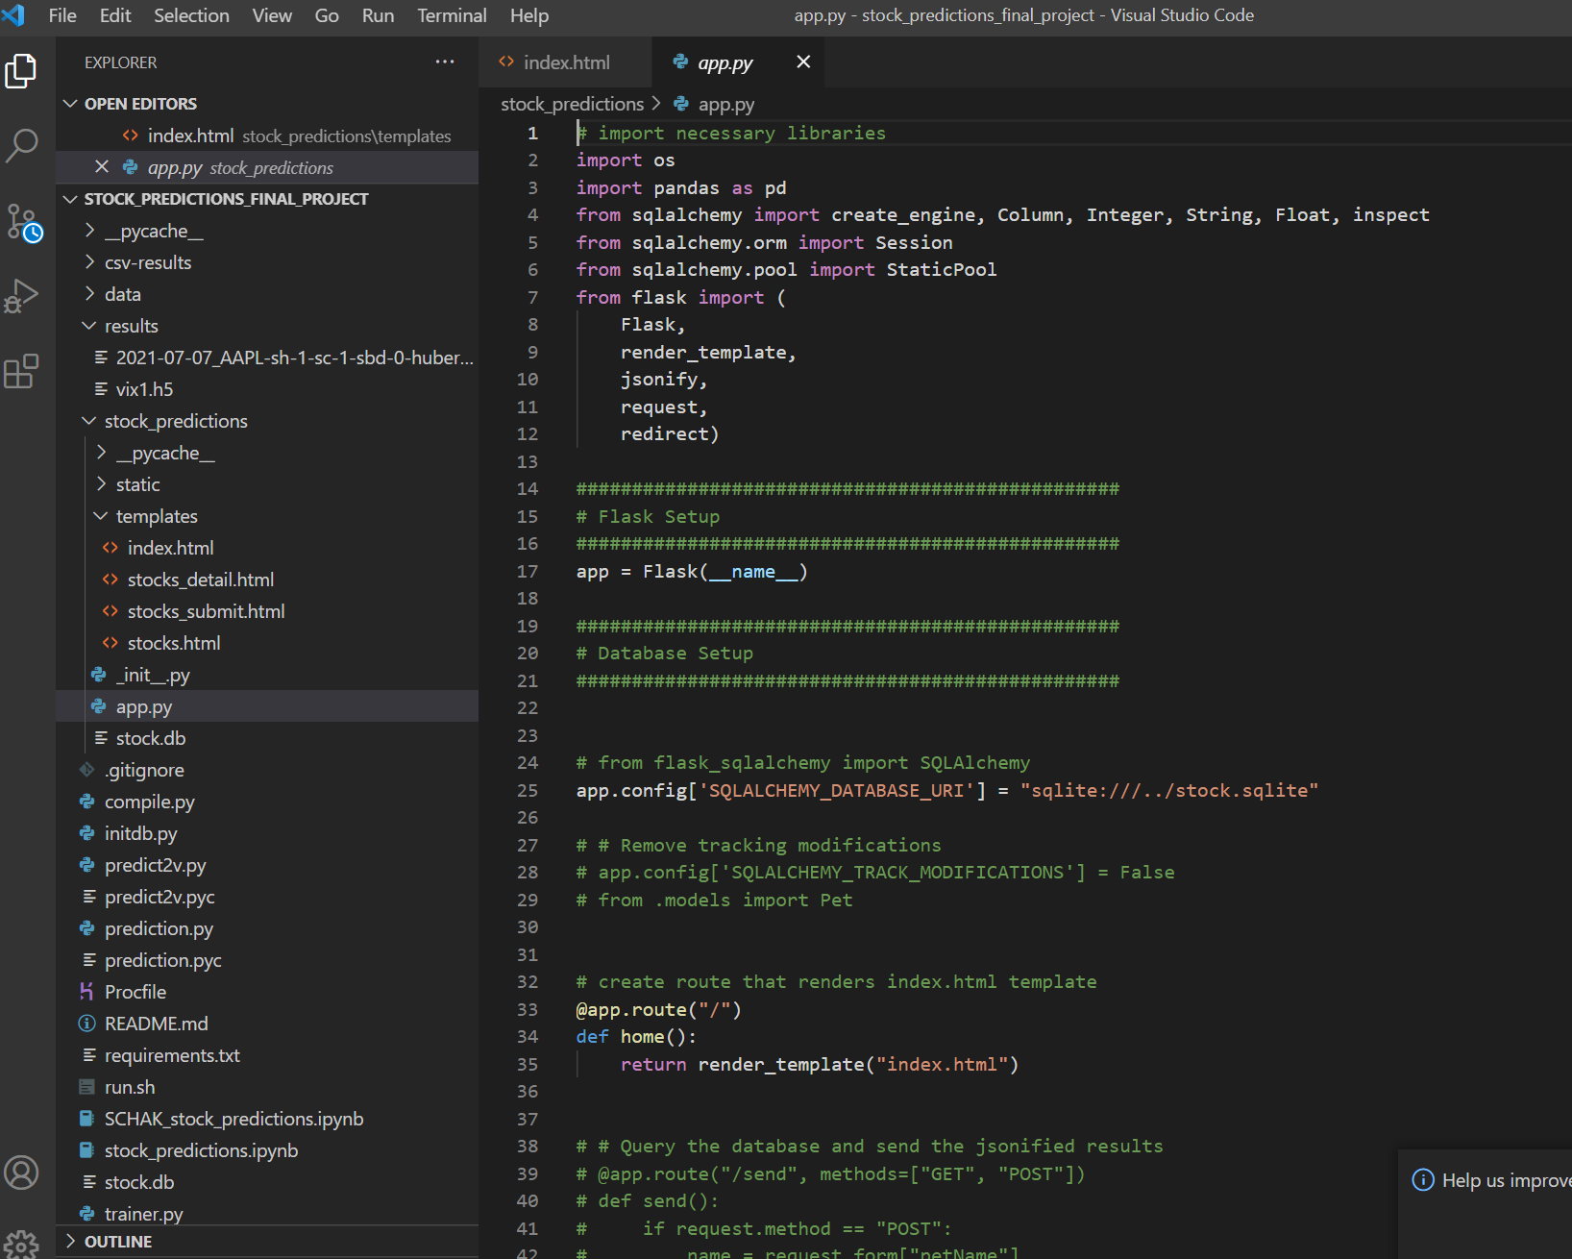


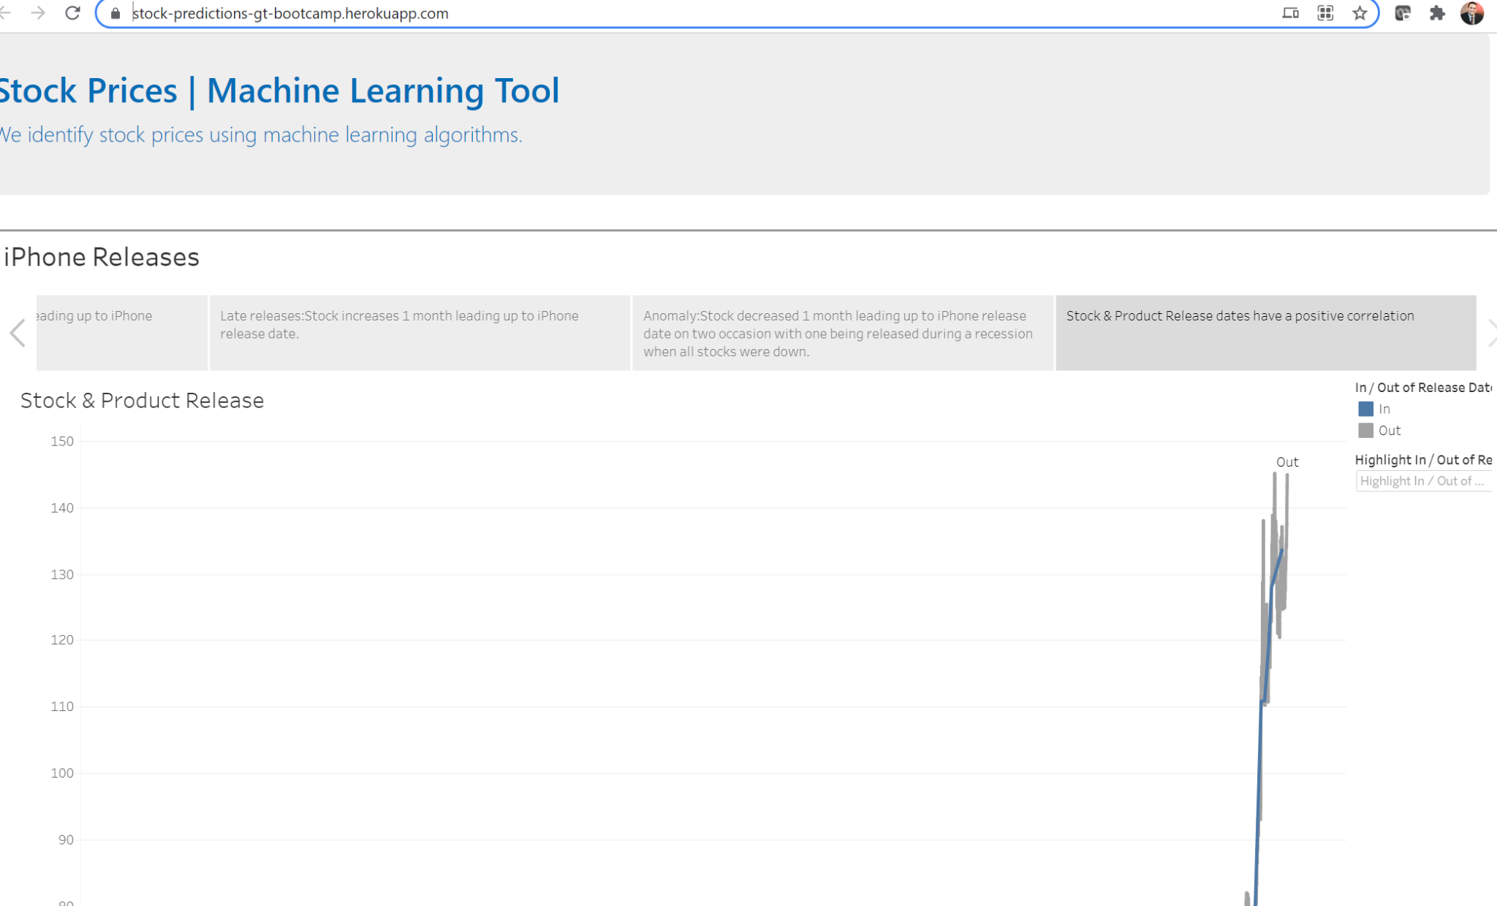
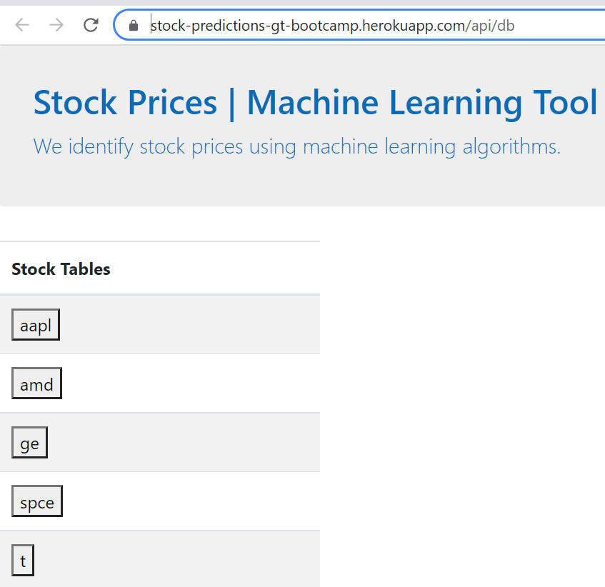
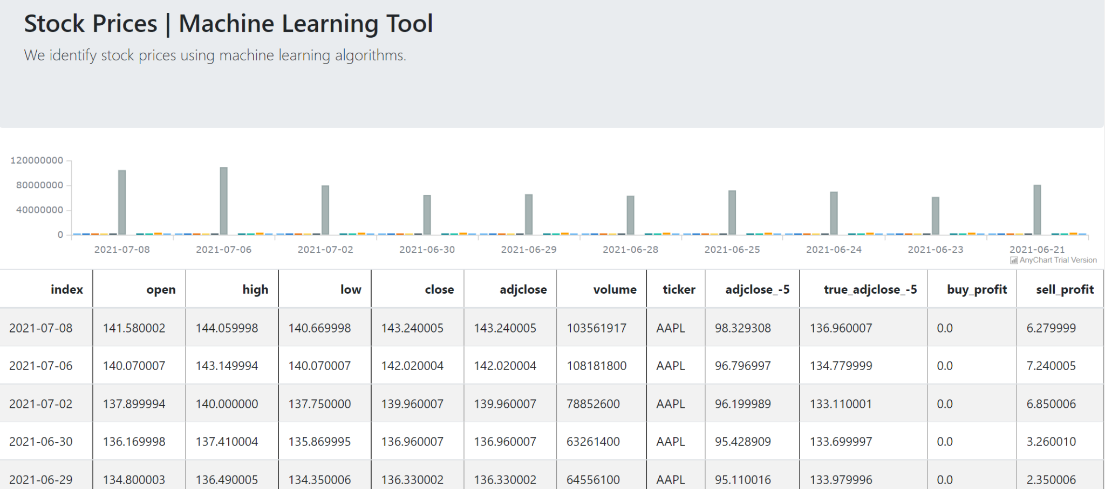
Final View
Danielle
https://stock-predictions-gt-bootcamp.herokuapp.com/
https://stock-predictions-gt-bootcamp.herokuapp.com/api/db
https://stock-predictions-gt-bootcamp.herokuapp.com/api/db

Slide 7
Billy will take us through an Infrastructure walkthrough

Slide 8

We bearly made it, and that’s no bull.

